Slide 1
Warm Up
If a box of cake mix can make 6 cupcakes and one small cake, how many sweet treats can I make with 13 boxes?
Notes:
Answers will vary

Slide 2
Distributive Property
What is it?

Slide 3
With Distributive Property
If a box of cake mix can make 6 cupcakes and one small cake, how many sweet treats can I make with 13 boxes?
Notes:
13(6+1) → 78+13=91 sweet treats

Slide 4
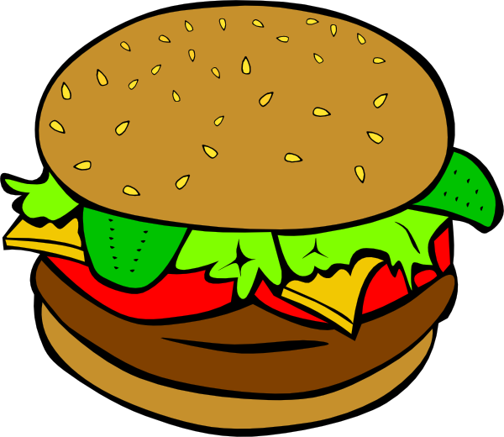
Combo Meal 1
Notes:
(2h+f+d)
With 5 friends getting the same combo: 5(2h+f+d) → 10h+5f+5d

Slide 5
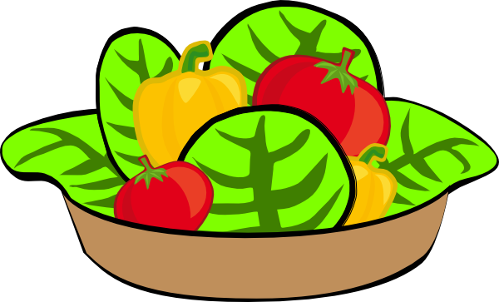
Combo Meal 2
Notes:
(s+b+c+d+2a)
With 8 friends: 8(s+b+c+d+2a) → 8s+8b+8c+8d+16a

Slide 6
Combo Meal 3
Notes:
Expression should look like: 1h+2s+3d+3c+4a with h=hamburger, s=salad, d=drink, c=cookie, a=apple
EXAMPLE: say that 3 people will be eating this combo. What would it now look like: 3(1h+2s+3d+3c+4a) --> 3h+6s+9d+9c+12a

Slide 7
Notes:
A place for students to show their expressions for the Combo Meal 3

Slide 8
What would these look like?
3a(4b+c)=
-(4x²-u)=
½ z(y²-4)=
a(b+c)=
Notes:
3a(4b+c)=12ab+3ac
-(4x²-u)=-4x²+u
1/2z(y²-4)= 1/2y²z-2z
a(b+c)=ab+ac

Slide 9
So you run a smoothie stand and there are some constants in your smoothie ingredients that are constantly running out.
A bag of apples cost $10, a bag of kiwis cost $8, a bundle of bananas cost $5, and sales tax is 0.08 here in Ellensburg, WA.
Notes:
0.08(10a+8k+5b) → 0.8a+0.64k+0.4b

Slide 10
How much would I have to give the cashier if I get 5 bags of apples, 3 bags of kiwis, and 6 bundles of bananas?
Notes:
0.8a+0.64k+0.4b → 0.8(5)+0.64(3)+0.4(6)=4+1.92+2.4=8.32
10a+8k+5b → 10(5)+8(3)+5(6)=50+24+30=104
104+8.32=$112.32

