Slide 1
Meatballs
(adapted from three-act task by Dan Meyers

Slide 2
CCSS.MATH.CONTENT.8.G.C.9
Geometry
“Solve real-world and mathematical problems involving volume of cylinders, cones, and spheres.”
9. Know the formulas for the volumes of cones, cylinders, and spheres and use them to solve real-world and mathematical problems.

Slide 3
Lesson Overview & Objectives
This is an 8th grade end-of-unit lesson on volume. It is expected that prior to this lesson students would have learned how to calculate the volume of various geometric shapes such as a sphere and a cylinder.
In this lesson, students will be able to solve a real-world mathematical problem related to volume by using the formulas for volume of a cylinder and volume of a sphere to help them calculate how many meatballs it will take to completely fill up the plastic container. They will be able to justify how they got their answer and how they know their answer was correct.

Slide 4
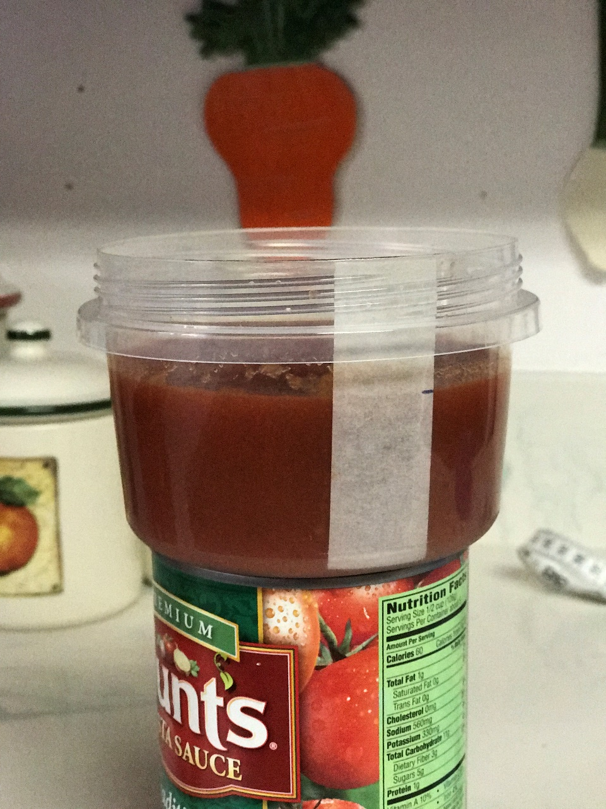
How many meatballs will it take to completely fill this plastic container?

Slide 5
What information do you need to know here? Discuss with an elbow partner.

Slide 6
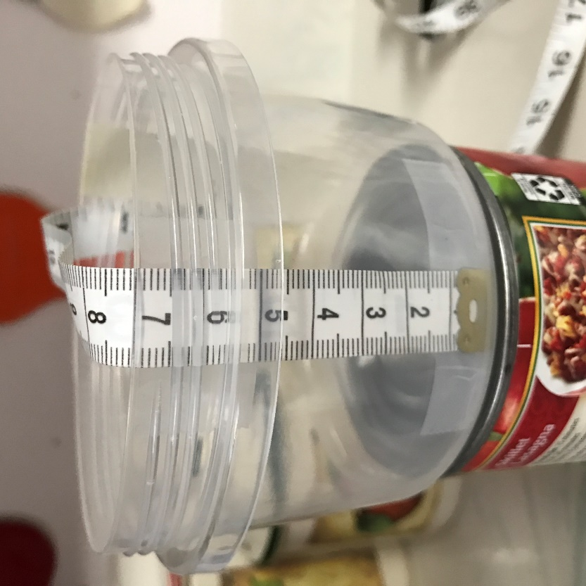
7 cm
4 cm

Slide 7
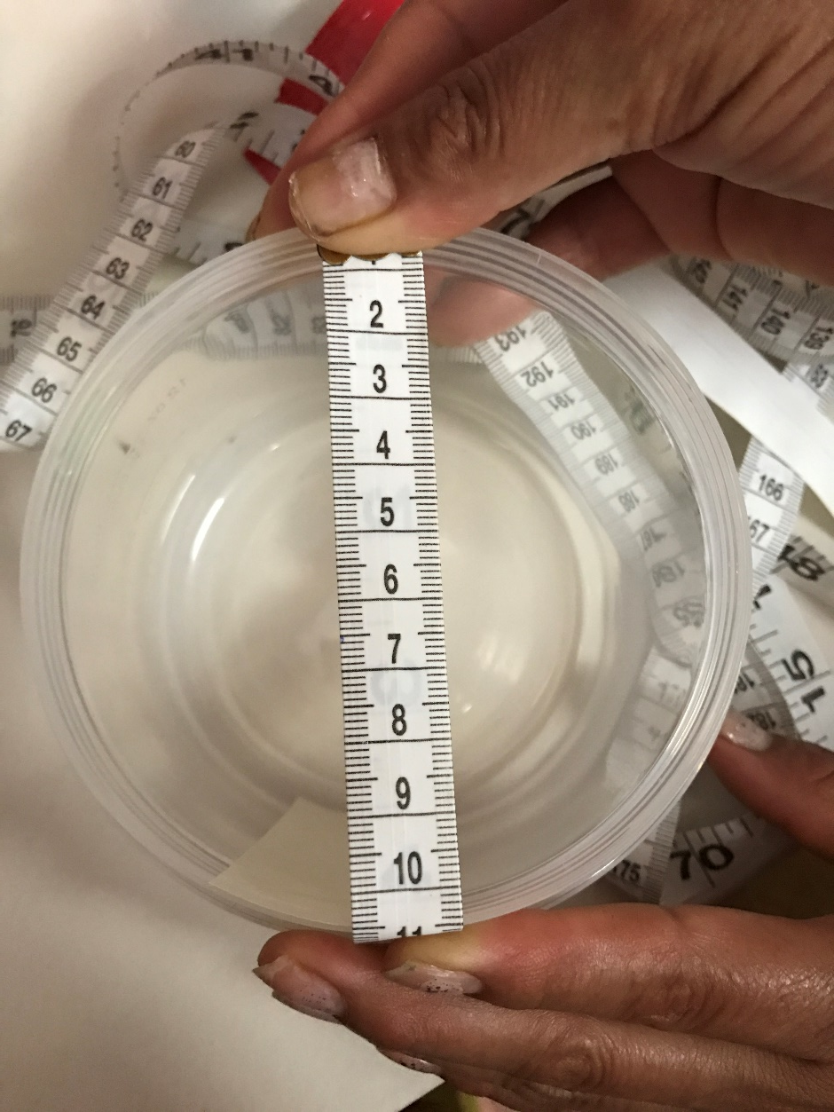
Diameter is 10.5 cm

Slide 8
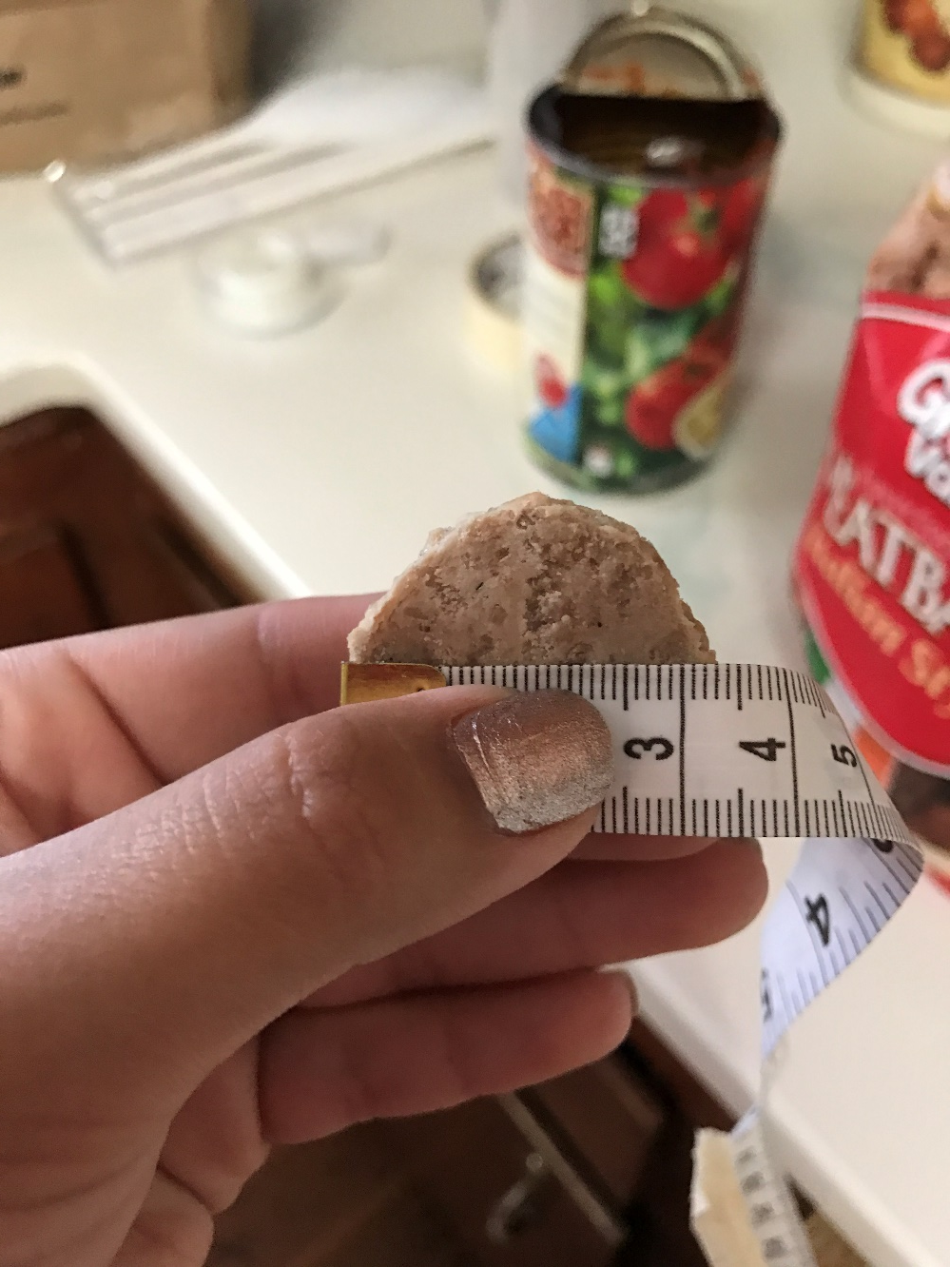
Diameter is 3.3 cm
(Signature kitchens diameter is 4 cm)

Slide 9
Ready for the answer?

Slide 10
https://youtu.be/3g_cJtc16-U

